Slide 1
Safe and Nested Subgame Solving for Imperfect-Information Games
Name: Janmejay Mohanty
CWID: 20009315
Email Id: Jmohanty@stevens.edu

Slide 2
Summary
Unlike perfect information games, the imperfect one’s cannot be solved by simply decomposing the game into several subgames which are solved independently. Therefore, we used more intense computational equilibrium searching approaches and methods and all decisions must consider the strategy of the whole game. While it’s not possible for an imperfect information game to solve by the method of decomposition, it’s possible to get approximate results or improving existing solutions, by solving the disjoining subgames.
This method is known as subgame solving.
We introduce subgame solving methods that can beat both prior techniques in theory as well as practical. We also demonstrates how to adapt them and past subgame-solving methods for responding to each opponent actions which are outside of the original action abstraction.
Subgame solving is a major part of Libratus, the first Artificial Intelligence to defeat top humans in heads-up no-limit Texas hold’em poker.

Slide 3
Introduction
Imperfect-information games model strategic settings that have hidden information. They have a countless applications including negotiation, cybersecurity and physical security. In these type of games, the goal is to find a Nash Equilibrium, which is a profile of strategies – one for each player – such that no player can improve by one-sided deviating to a different strategy.
Subgame solving is a standard method for perfect-information games, for example: chess and checkers, in which a part of game is solved in an isolation state. It can be achieved in perfect-information games as the exact state of game is known, which allows remaining subgame to be solved independently from the rest of the game.
For example: In chess, to determine the optimal response to the Queen’s Gambit requires no knowledge of the optimal response to the Sicilian Defense. This decomposition was the major component for AI’s being able to defeat top humans in chess and Go.

Slide 4
Nash Equilibrium
The Nash equilibrium is a decision-making theorem within game theory that states a player can achieve the desired outcome by not deviating from their initial strategy.
In the Nash equilibrium, each player's strategy is optimal when considering the decisions of other players.
For example: Chess is a zero-sum game, so all Nash equilibria will lead to the same of three outcomes: White wins, Black wins and Draw.

Slide 5

Coin toss
Coin toss is played between two players ($P_{1}$ and $P_{2}$).
A flipped coin has only two possible outcomes either Heads or Tails with equal probability.

Slide 6
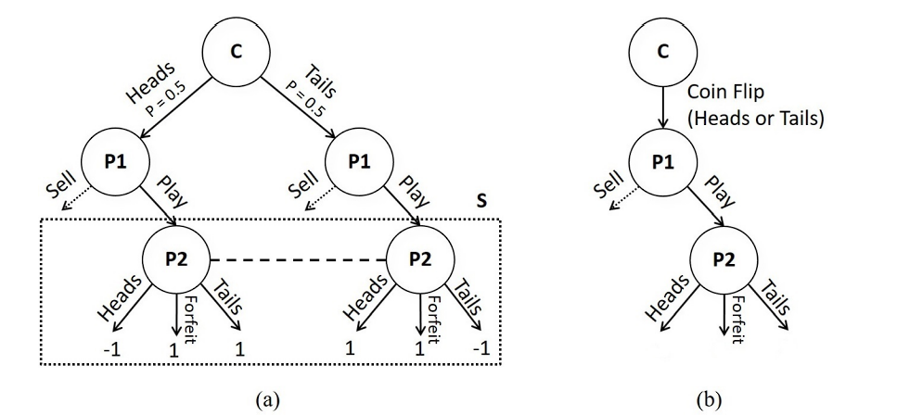

Coin toss game problem
Figure1: (a) The example of Coin Toss game. “C” represents a chance node. S is a Player 2 ($P_{2}$) subgame. Dotted line between the two $P_{2}$ nodes means that $P_{2}$ can’t distinguish between them. (b) The public game tree of Coin Toss. The two outcomes of the coin flip are only observed by $P_{1}$.

Slide 7

Some Notation and Background
In an imperfect-information extensive-form game, there is a finite set of players, $𝒫$.
H is set of all possible histories (nodes) in the game tree, represented as a sequence of actions, and includes the empty history.
A(h) is the actions available in a history and P(h) $ε$ $𝒫$ $∪$ c is the player who acts at that history, where c denotes chance.
History h’ reached after an action is taken in h is a child of h, represented by $h.a$=h’, while h is the parent of h’.

Slide 8

Nash equilibrium
A Nash equilibrium is a strategic profile $σ^{∗}$ such that $∀i, u_{i}\left(σ_{i}^{∗},σ_{−i}^{∗}\right)=\max_{σ^{′∗}}{∈} \sum_{i}{u_{i}}(σ_{i}^{∗},σ_{−i}^{∗})$ .
For two-player zero-sum games, all Nash equilibrium give identical expected values for a player.

Slide 9
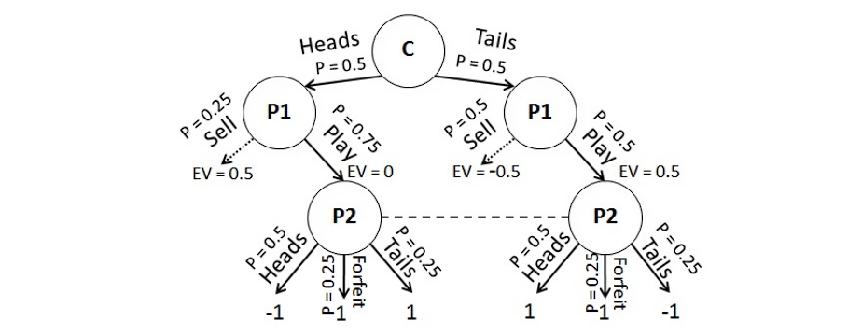

Prior approached to subgame solving in imperfect-information games
Figure 2: The trunk strategy we refer to in the game of Coin Toss. The Sell action leads to a subgame that is not displayed. Probabilities are shown for all actions. Since both $P_{2}$ nodes share an information set, the probabilities over actions for each node must be identical. The counterfactual best response value of each $P_{1}$ action is also shown.

Slide 10
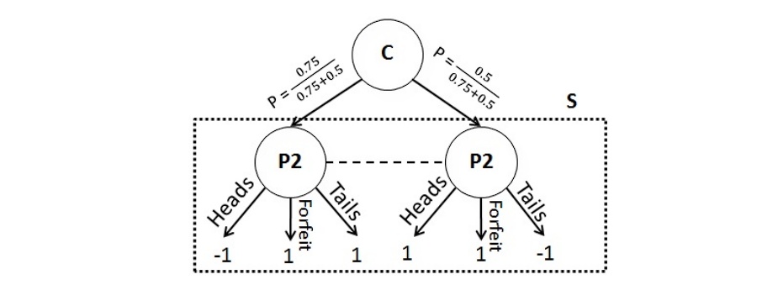
Unsafe subgame solving
Figure 3: The augmented subgame solved by Unsafe subgame solving to determine a $P_{2}$ strategy in the Play subgame of Coin Toss.

Slide 11
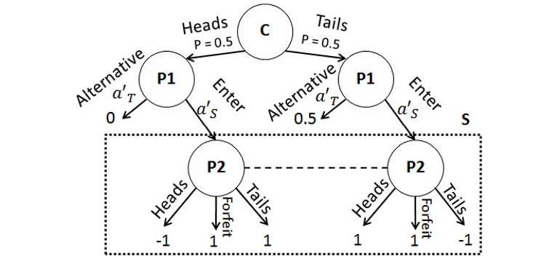
Subgame re-solving
Figure 4: The augmented subgame used by re-solving to determine a P2 strategy in the Play subgame of Coin Toss.

Slide 12

Max margin solving
Maxmargin solving method is similar to Re-solving, except it seeks to improve $P_{2}$’s strategy in the subgame strategy as much as possible.
While Re-solving seeks for a strategy for $P_{2}$ in S that would simply prevent $P_{1}$ from entering S, Maxmargin solving additionally seeks to punish $P_{1}$ as much as possible if $P_{1}$ nevertheless chooses to enter S.
A subgame margin is defined for each info set in $S_{r}$, which represents the difference in value between entering the subgame versus choosing the alternative payoff.
The subgame margin is $M^{σ^{S}}\left(I,a_{S}\right)=v^{σ^{S}}\left(I,a_{T}^{′}\right)−v^{σ^{S}}(I,a_{S}^{′})$

Slide 13
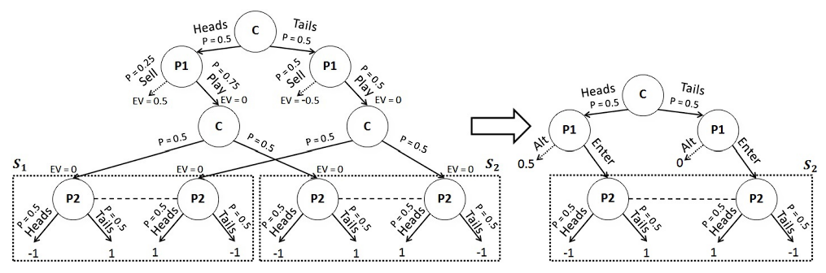

Solving multiple subgames independently
Figure 5: Left: A game with two subgames. The nodes $C_{1}$ and $C_{2}$ are public chance nodes whose outcomes are seen by both $P_{1}$ and $P_{2}$. Right: An augmented subgame for one of the subgames. If only one of the subgames is being solved, then the alternative payoff for Heads can be at most 1. However, if both are solved independently, then the gift must be split among the subgames and must sum to at most 1. For example, the alternative payoff in both subgames can be 0.5

Slide 14

Modeling error in a subgame
When solving multiple $P_{2}$ subgames, there is a minimally-exploitable strategy $σ^{2}$ that could, in theory, be computed by changing only the strategies in the subgames. ($σ^{2}$may not be a Nash equilibrium because $P_{2}$’s strategy outside the subgames is fixed, but it is the closest that can be achieved by changing the strategy only in the subgames).
However, $σ^{2}$ can only be guaranteed to be produced by solving all the subgames together, because the optimal strategy in one subgame depends on the optimal strategy in other subgames.

Slide 15
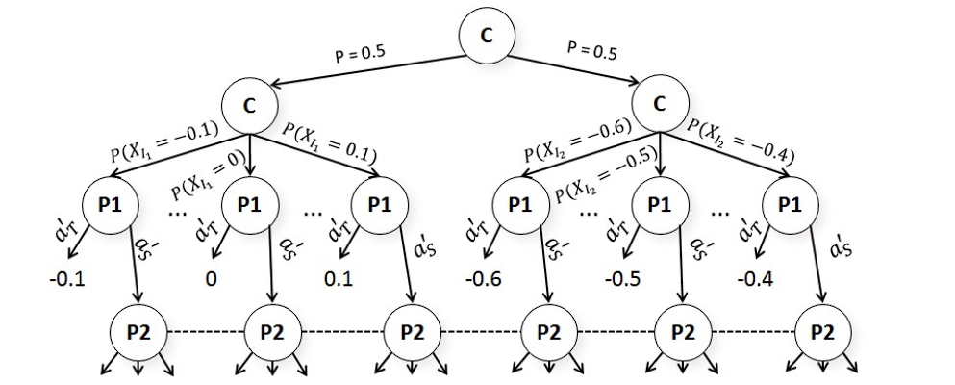
Distributional alternative payoffs
Figure 6: A visualization of the change in the augmented subgame from Figure 4 when using distributional alternative payoffs.

Slide 16
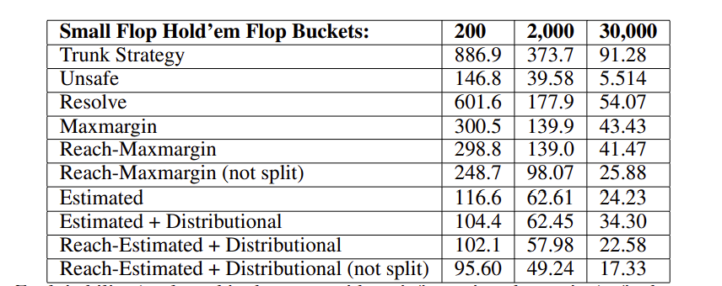
Experiments results
Table 1: Exploitability (evaluated in the game with no information abstraction) of subgame-solving in small flop Texas hold’em.

Slide 17
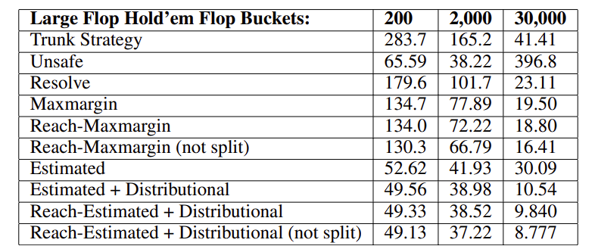
Table 2: Exploitability (evaluated in the game with no information abstraction) of subgame-solving in large flop Texas hold’em.

Slide 18
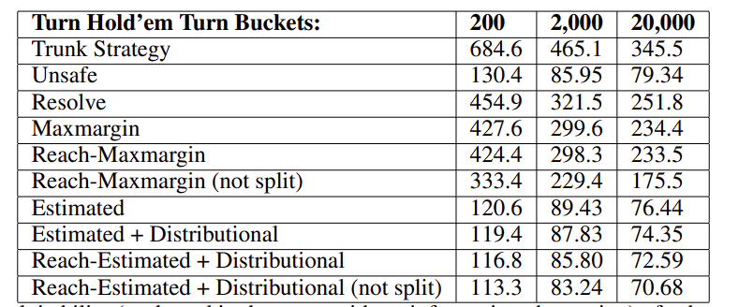
Table 3: Exploitability (evaluated in the game with no information abstraction) of subgame-solving in turn Texas hold’em.

Slide 19
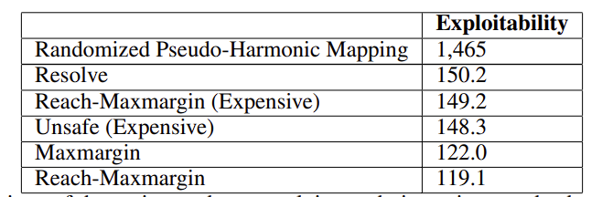
Table 4: Comparison of the various subgame solving techniques in nested subgame solving. The performance of the pseudo-harmonic action translation is also shown. Exploitability is evaluated in the large action abstraction, and there is no information abstraction in this experiment.

Slide 20
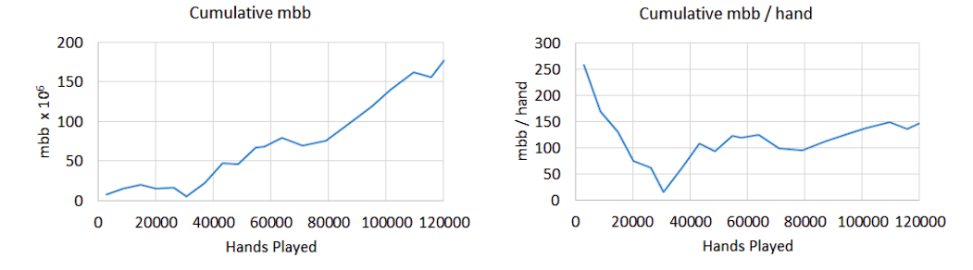
Evaluation against top humans
Figure 7: Libratus’s performance over the course of the 2017 Brains vs. AI competition.

Slide 21
Conclusion
We introduced a subgame solving method for imperfect-information games which has stronger theoretical guarantees and better practical performance than prior subgame-solving methods.
We show results on exploitability for both safe and unsafe subgame solving methods.
We also discussed and used a method for nested subgame solving in response to the opponent’s off-tree actions, and demonstrated that it leads to a dramatically better performance than usual approach of actions.
Finally, we showed the effectiveness of these methods in practical against top human professionals in the game of heads-up no-limit Texas hold’em poker the main benchmark challenge for AI in imperfect-information games.
In 2017 Brains vs. AI competition, our AI Libratus became the first AI to reach the milestone of defeating top humans in heads-up no-limit Texas hold’em.

Slide 22
THANK YOU

